Slide 1
CS 0447 Recitation 9

Slide 2
Last Week’s Quiz
Q1
A: By checking if the two MSBs are different
This is the same procedure as for addition, since subtraction is defined as adding a negative
Q2
A: 10110100
This is an XOR, so the output is 1 when one (but not both) inputs are 1.
Q3
A: We don't care what that value is
Notes:
Q1: How can you check for overflow during subtraction when using one-bit (full) adders?
Q2: What is the result of 11011010 ⊕ 01101110
Q3: When dealing with tables representing the boolean logic of a circuit, what does an X represent for a particular input?

Slide 3
Last Week’s Quiz
Q4
A: Multiplexer
A multiplexer (mux) will send one of its inputs to its output based on a select
Q5
A: A multiplexer does all of the possible actions, and ignores the ones we don't care about
All of the inputs to the mux “happen” – we just only use one of them.
Notes:
Q4: What hardware component outputs one of it's inputs based on a select?
Q5: Which of the following is a key difference between a multiplexer and a software if-else statement?

Slide 4
This Week’s Quiz
5 minutes to work on the quiz as usual

Slide 5
Minimization
Minimization means to use the smallest possible number of gates/transistors to implement a boolean function
We want to minimize circuits because
Transistors cost money
We can fit more onto one chip
There is a lower chance that a given circuit has a manufacturing defect
Circuits will be faster

Slide 6
Minimizing Boolean Functions
We want to minimize this function: Q = AB + A~B
If, when two terms are OR’d, only one variable changes, we can remove that variable!
AB + A~B = A(B + ~B)
B or ~B is always true! Expression becomes A and 1
A and 1 is just A: Q = A
However: with more complex functions this becomes difficult

Slide 7
Karnaugh Maps
Instead of relying on boolean algebra, we use Karnaugh maps (K-maps)
A K-map is a visual tool we can use to minimize a boolean function
It’s much easier to work with than boolean algebra!

Slide 8
Building a K-Map
Let’s start with the truth table for the carry-out of a full adder
C_in | A | B | C_out
0 | 0 | 0 | 0
0 | 0 | 1 | 0
0 | 1 | 0 | 0
0 | 1 | 1 | 1
1 | 0 | 0 | 0
1 | 0 | 1 | 1
1 | 1 | 0 | 1
1 | 1 | 1 | 1

Slide 9
Building a K-Map
We write the variables along the edges of a rectangle using gray code
In a way that only one variable changes at once
If there are more than two variables, we just write two of them on the same axis
 | ~A~B | ~AB | AB | A~B
~C | 0 | 0 | 1 | 0
C | 0 | 1 | 1 | 1

Slide 10



Using a K-Map
We want to find rectangles of 1s!
If we have “don’t cares” those can also be part of our rectangles
The sides of the rectangles must have a length that’s a power of 2
1, 2, 4, …
They can also wrap around top to bottom or side to side
 | ~A~B | ~AB | AB | A~B
~C | 0 | 0 | 1 | 0
C | 0 | 1 | 1 | 1

Slide 11
Using a K-Map
A rectangle represents an adjacency
The “output” from a rectangle is the terms involved that did not change
So here: red = AB, blue = BC, and green = AC
Or those terms together: AB + BC + AC
And that’s our minimized expression!
 | ~A~B | ~AB | AB | A~B
~C | 0 | 0 | 1 | 0
C | 0 | 1 | 1 | 1

Slide 12
K-Map Notes
You must encode the inputs using Gray Code
Otherwise more than one variable could change at once, and the K-Map won’t work
Try to use the largest rectangles possible and the fewest possible
This ensures our minimized function is indeed minimal
Rectangles can overlap, as well as reach around the borders of the map
Don’t cares can be used as either 1s or 0s – whichever helps you more

Slide 13
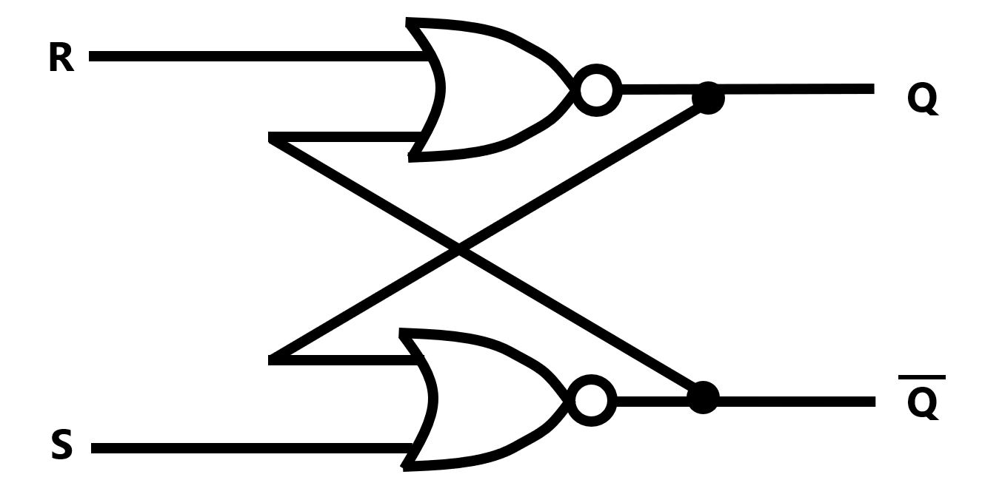
S/R Latches
These are pretty wild
We can use an S/R latch to store a value using circuitry!

Slide 14

Setting an S/R Latch
We can set the value of an S/R latch to 1 by setting S to 1
The 1 sort of works its way over to Q
And then the latch now holds a 1!

Slide 15
Latching an S/R Latch
If we want to maintain the current value in the latch, we set both S and R to 0
This will work regardless of whether we’re trying to maintain a 0 or a 1

Slide 16

Resetting an S/R Latch
We can reset an S/R latch by setting R to be 1
More or less the same thing happens as when we set S to one, but now Q becomes 0

Slide 17
S/R Latches and Sequential Logic
A latch is an example of sequential logic
The state of the latch depends on its previous state
Sequential logic will come up often in the rest of the course

Slide 18
Propagation Delay
If the state of a latch depends on its previous state, then Q at time = 1 is different than it was at time = 0
The amount of time it takes for the change to occur is bounded by propagation delay
Propagation delay is the amount of time it takes a signal to travel from an input to an output
During that delay, the outputs are invalid
After the delay, they’re valid

Slide 19
Critical Path
The critical path is the path through a circuit that has the longest series of sequential operations
That is, operations that depend on each other
They therefore cannot be parallelized
The longest propagation delay is the one found on the critical path
Let’s say we have a component connected to an S/R latch that depends on the latch’s output
It needs to wait until the latch’s output is updated

Slide 20
The Clock
Sequential logic is based on time, so we need some way to keep track of time
We use a clock signal: it oscillates between 0 and 1
1, 0, 1, 0, 1, 0 …
Each period is called a clock cycle
We can sync our circuits either a high (1) or low (0) state of the clock

Slide 21
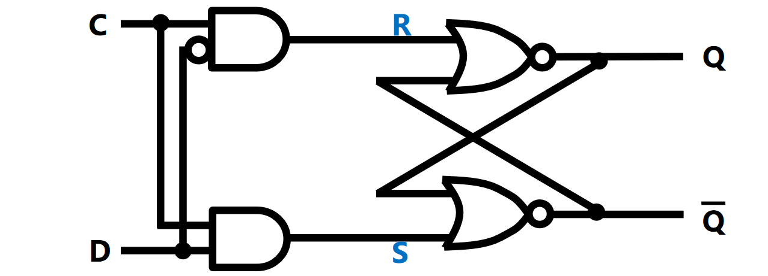
D Latch
We can add a clock onto an S/R latch to create a D-latch
C is the clock and D is the data to store
This will change when the clock is 1 and latch when it is 0

Slide 22
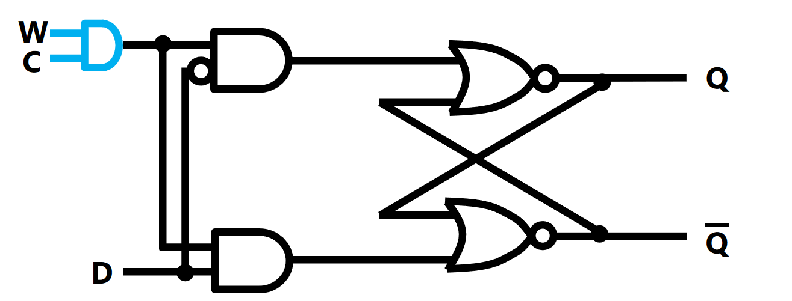
D Latch Problem
If the clock is connected directly to the D-latch, we have to constantly keep D set
Otherwise the value in the latch will change
Solution: Add a write-enable input that turns on writing to the latch

Slide 23
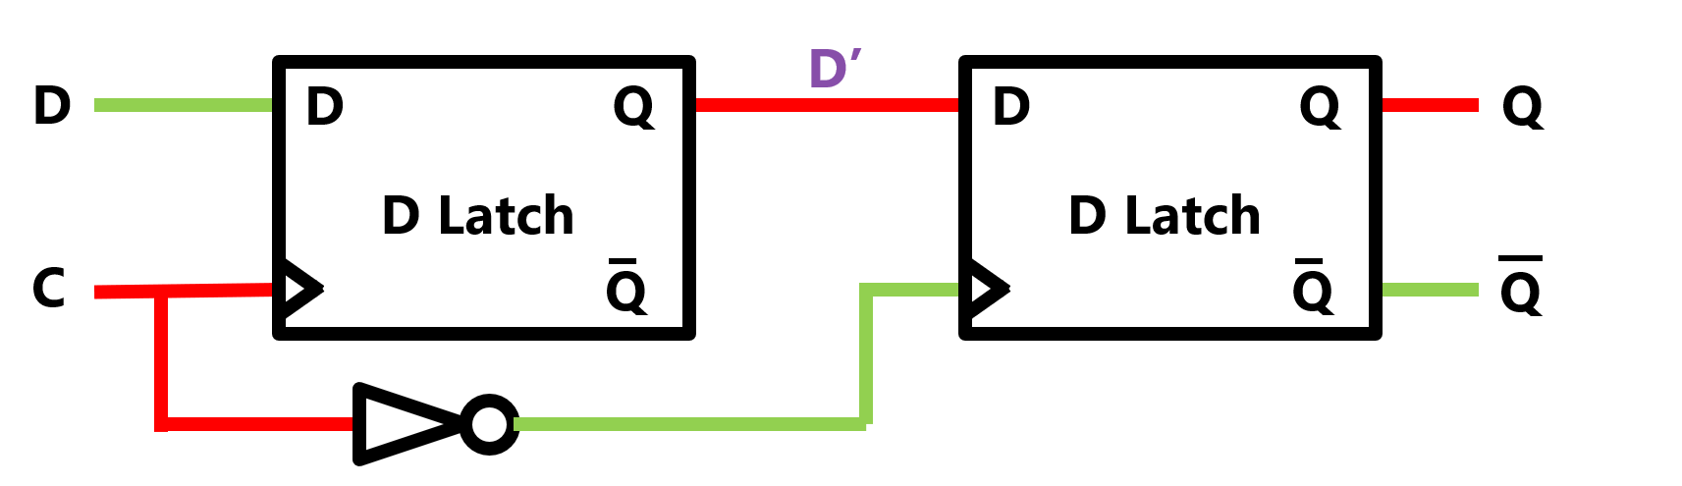
Creating a Register
We can connect 2 D-latches together to create a register
When the clock is high, D’ is computed, but Q is not
Then, on a falling clock (when the clock goes from high to low) edge, D’ is copied into the second latch
This is a one-bit register!

Slide 24
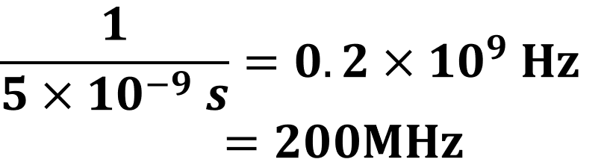
Determining Clock Speed
Let’s say it takes 5s for a signal to propagate through our critical path
If the time between clock cycles is less than 5 ns, we’ll get invalid outputs
If the time between cycles is more than 5ns, that’s fine
Clock speed is measured in hertz, which tells us how many times per second something happens
Therefore, the maximum possible clock speed is 1 divided by the critical path propagation delay

Slide 25
Lab 9 Part A
We talked about using K-Maps to minimize boolean expressions
Part A of the lab deals with doing this
However! Logisim has a built in tool to do this for you
Window -> Combinatorial Analysis
Your task is to use Logisim to minimize the given truth table and implement a circuit
It is still a good idea to do the minimization by hand to check your understanding

Slide 26
Lab 9 Part B
This part also deals with minimization
You are tasked with creating a minimized circuit that controls the 7-segment LED display
You should solve the K-map for each output, then build the circuit
It’s tempting to use Logisim’s tool again, but you won’t have it on the exam
So you should do this by hand to practice
Submit the circuit you build that controls the LED display

